Slide 1
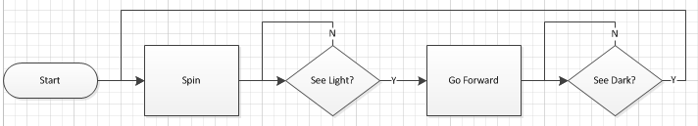
FlowCharts
What does this describe?
Flashlight Follower
Program Flow

Slide 2



FlowCharts
Elements
Start/End
  Start, always
  End, sometimes
Process
  Do something
Decision
  Binary only
  Yes or No
Program Flow

Slide 3
FlowCharts
Create a FlowChart for the
Dragster Challenge program
Break task down into separate behaviors
Identify whether each behavior is a
Process or Decision block
Put the labeled blocks in order
(including Y/N on decision blocks)
Use Arrows to show program flow
Don’t forget the Start/End blocks

Slide 4
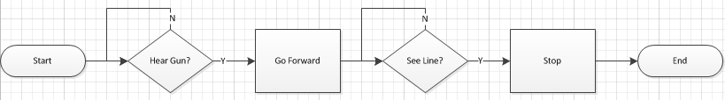
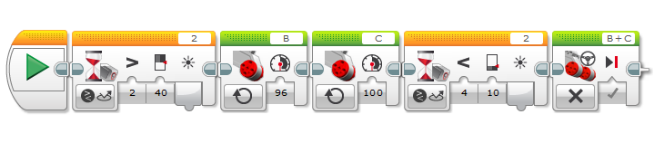
FlowCharts: Dragster Challenge
Flag Change?
Every FlowChart block behavior must be created in EV3-G
Every program has a Start block
Some programs have an End block:
  Implied by dangling beam in EV3-G
One Process block may imply more than one EV3-G block
A Decision block always implies some type of input:
  sensor, button, timer, counter, bluetooth, etc.

Slide 5
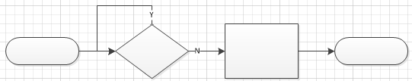
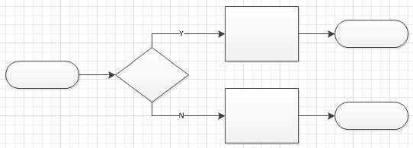
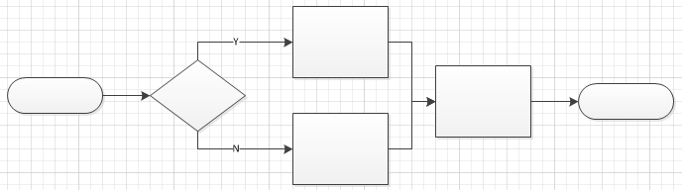
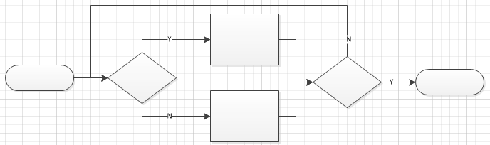
FlowCharts:
Decisions,
Decisions….
“Wait-for”
Loop
Parallel
Branches
Merged
Parallel
Branches
Looped
Parallel
Branches

Slide 6
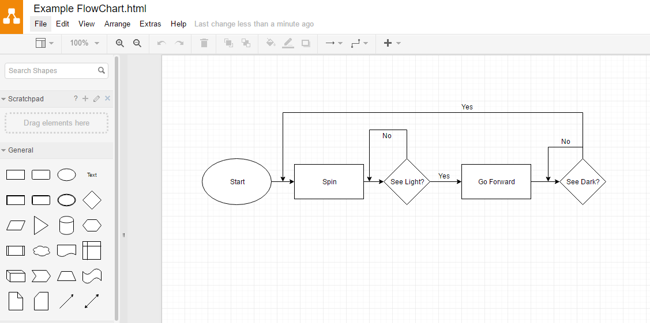
Creating FlowCharts
Flowcharting programs like Draw.io (shown below):
  Select “New Blank Flowchart”
  Use “General” Library
Right click on block, Edit to change.
Click/drag these blocks into place
Click/drag to connect blocks

